Slide 1
Funding for promoting innovations in SMEs?
Enterprise Europe Network-Hellas
Helping ambitious businesses innovate and grow internationally
www.enterprise-hellas.gr, @EEN_Hellas

Slide 2
Are you a business interested to innovate and expand abroad? Are you looking for new markets, funding, information on the Single Market?
4 services (and 4 success stories)

Slide 3
ΕΕΝ-Hellas: Who we are National & European Network
The world’s largest support network for SMEs with international ambitions, 600 organizations in >60 countries
Supported by the European Commission
12 partners from across the country, combining international business expertise with local knowledge: research centres, business associations, chambers of commerce and a development agency
Helping business grow faster through tailored support, new commercial partnerships and access to finance, without cost for SMEs
More than 550 transnational business and technological partnerships (2008-today)!

Slide 4
ΕΕΝ-Hellas: Who we are

Slide 5
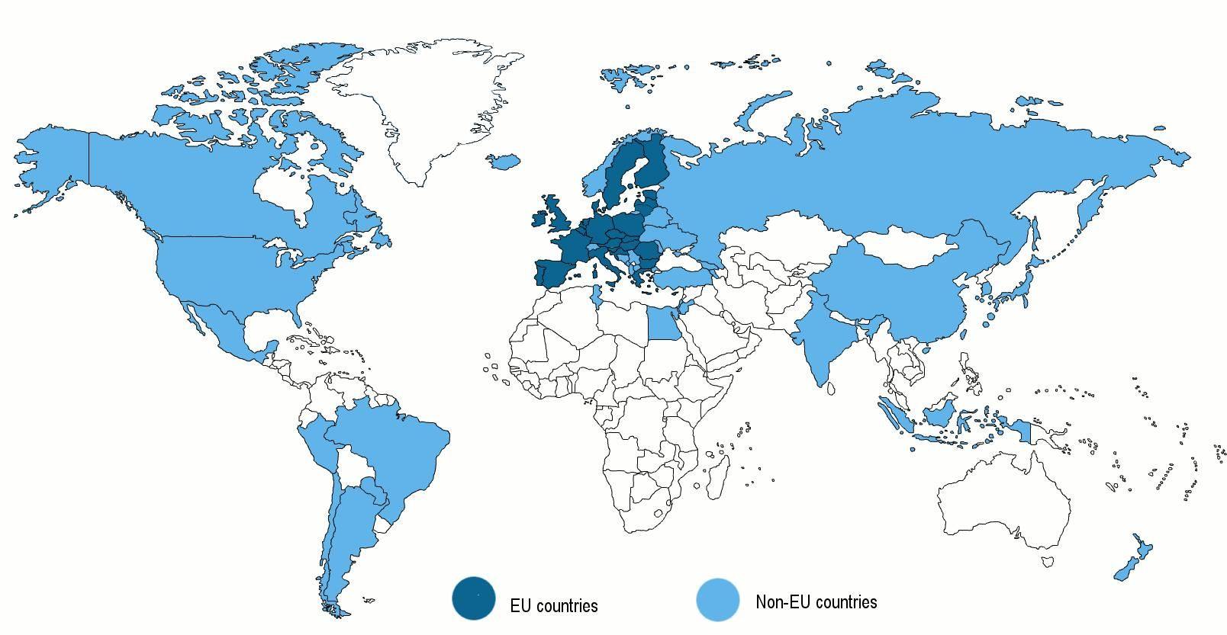
The world’s largest network for SMEs
600 organizations, >60 countries, operating since 2008
Notes:
Στόχος: Διακρατική συνεργασία

Slide 6
ΕΕΝ-Hellas: Services
1. Access to Markets
2. Access to Finance
3. Advice on EU policies
4. Innovation Management

Slide 7
ΕΕΝ-Hellas: Access to Markets(1)
Technology-Business Audits
Company Missions & Brokerage Events
Online matching of partnership profiles
Support on identifying business opportunities, market practices, standards, legal and tax issues, IPR, etc.
During 2013-2014:
121 Brokerage Events & Company Missions
150 transnational partnership agreements

Slide 8
ΕΕΝ-Hellas: Access to Finance (2)
Information & Advisory Services on funding instruments - ΕU programmes (Horizon 2020, COSME, etc.) - Structural Funds - Private investments & Alternative funding instruments: venture capital, business angels, seed financing, crowdfunding, among others.
Partner search, at international level, for joint proposal submission
Guidance on proposal writing/submission, etc.
During 2013-2014:
>3.500 queries on access to finance
>100 training seminars for SMEs

Slide 9
ΕΕΝ-Hellas: EU policies(3)
Advice on EU policies for SMEs (Small Business Act)
Consultations on important issues of SMEs throughout Europe
Information campaigns on issues of interest for SMEs (e.g. Safety & Healthy Workplaces)
During 2013-2014:
Support of information campaigns in Greece
Feedback of Greek SMEs to EU institutions for the adoption or revision of EU policies for SMEs

Slide 10
ΕΕΝ-Hellas: Innovation Management (4)
Innovation Audit & Management
Benchmarking of innovative SMEs (EU level)
Guidance on innovation strategy issues
Support of Greek SMEs in the SME Instrument programme for disruptive products / services
During 2014:
Innovation audits in 39 companies

Slide 11
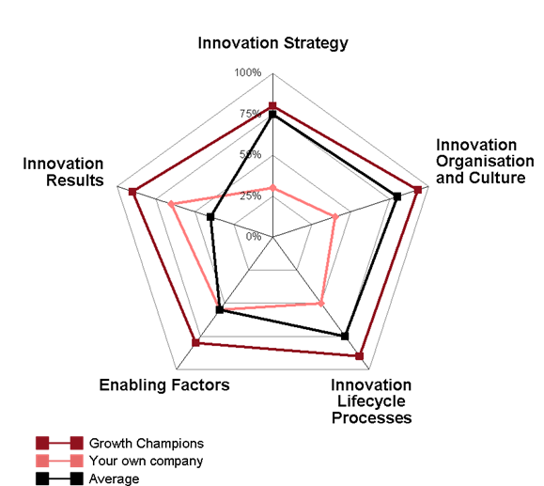
ΕΕΝ-Hellas: Expanding to new markets(1)

Slide 12
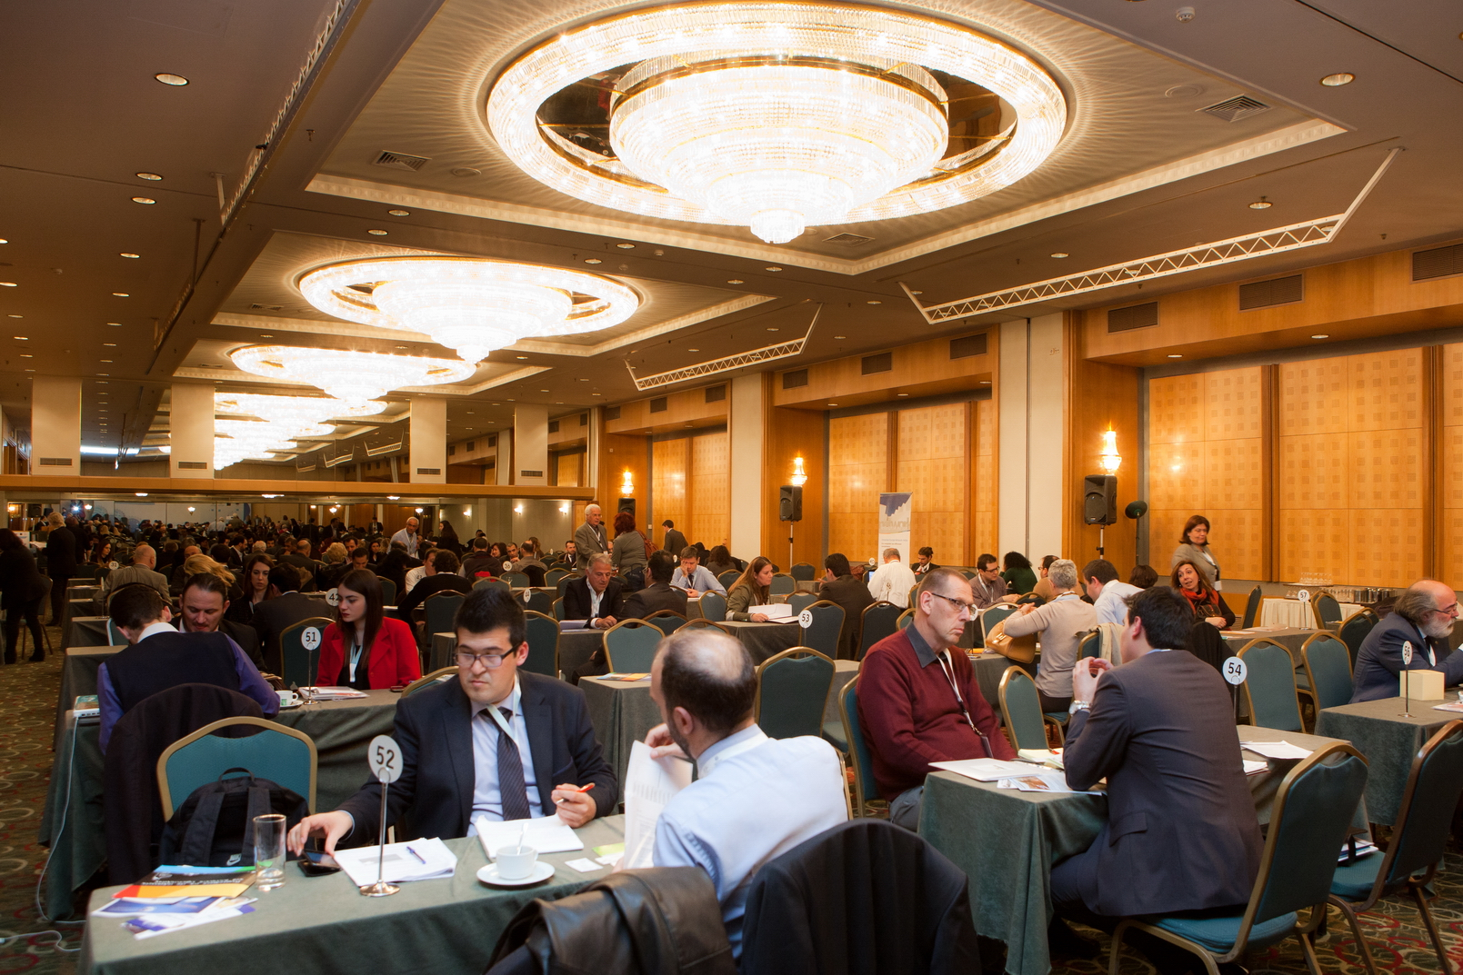
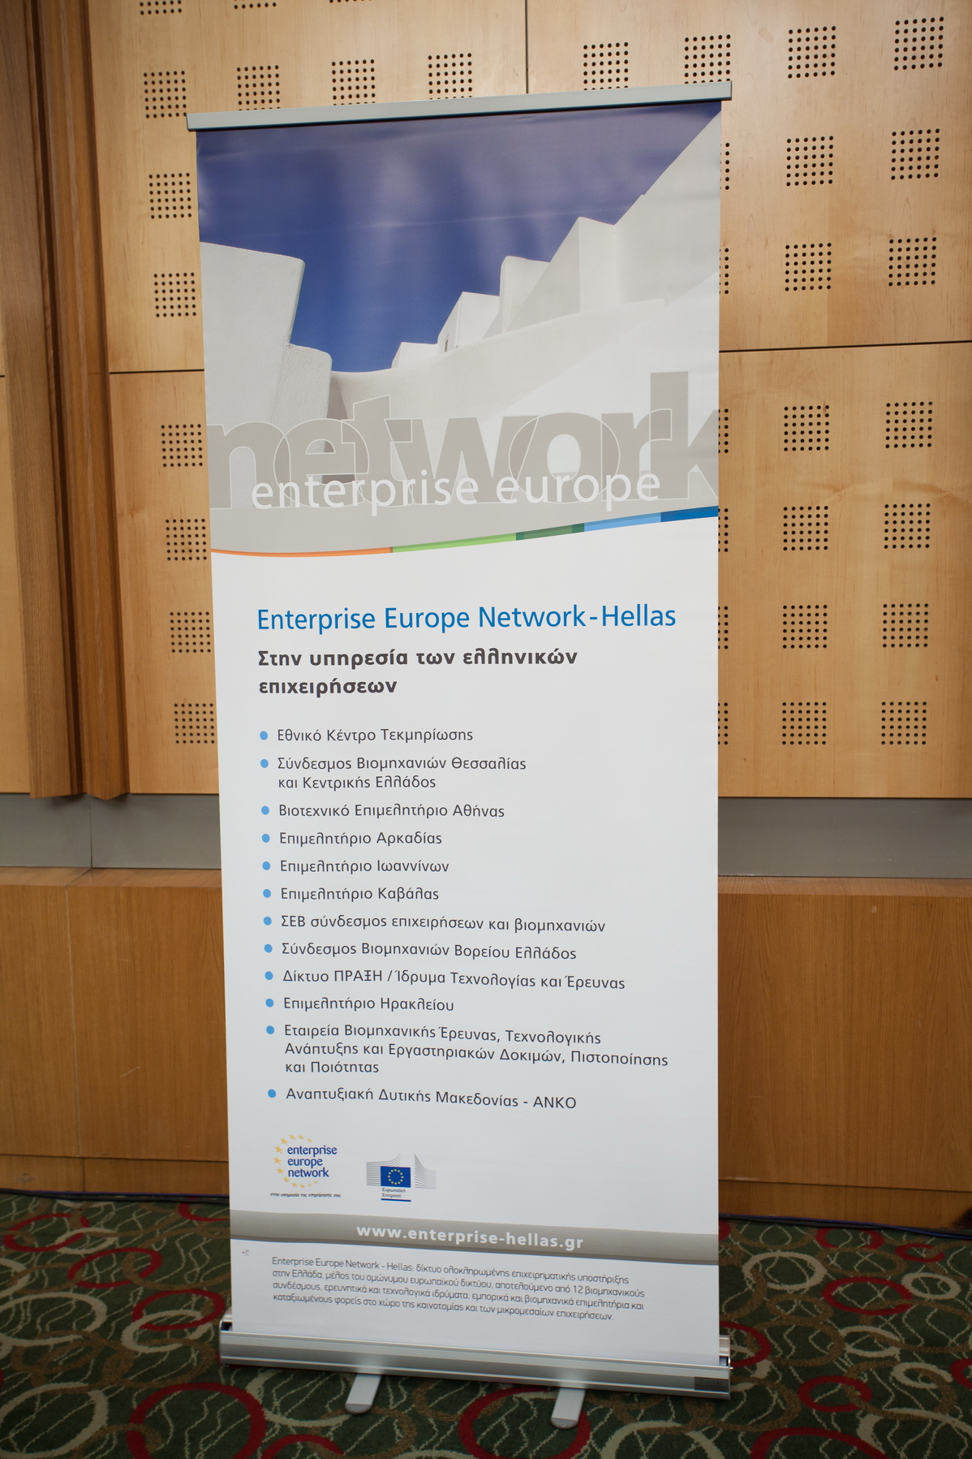
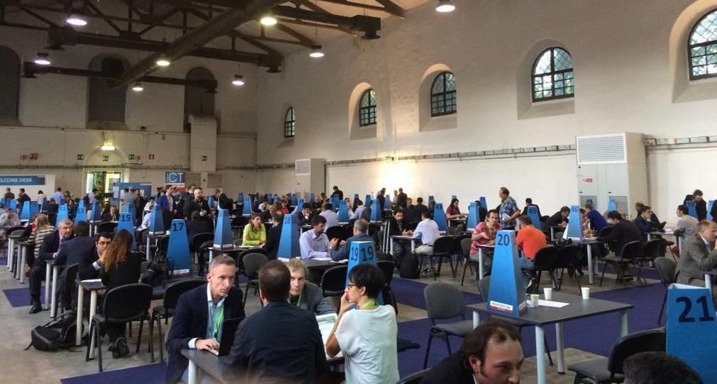
ΕΕΝ-Hellas: Business meetings record(2)
Period: 2013-2014
121 Β2Β & Company missions
1.858 Participants
6.365 Meetings

Slide 13
ΕΕΝ-Hellas: Transnational Partnerships(3)
Enterprise Europe Network brought together the German company TMTM & Greek company Campervan Rental Service for developing cycling tourism in Peloponnesus region.
Enterprise Europe Network supported the Greek start-up Crypteia Networks, focused on Cyber security & Threat Intelligence, in accessing finance, expanding to new EU markets, patenting IPR rights.

Slide 14
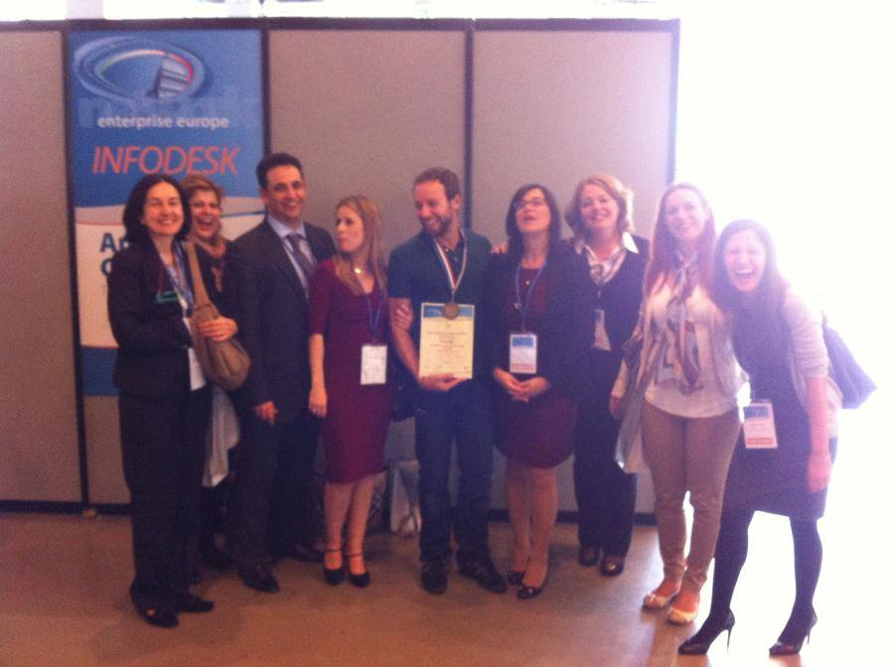
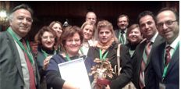
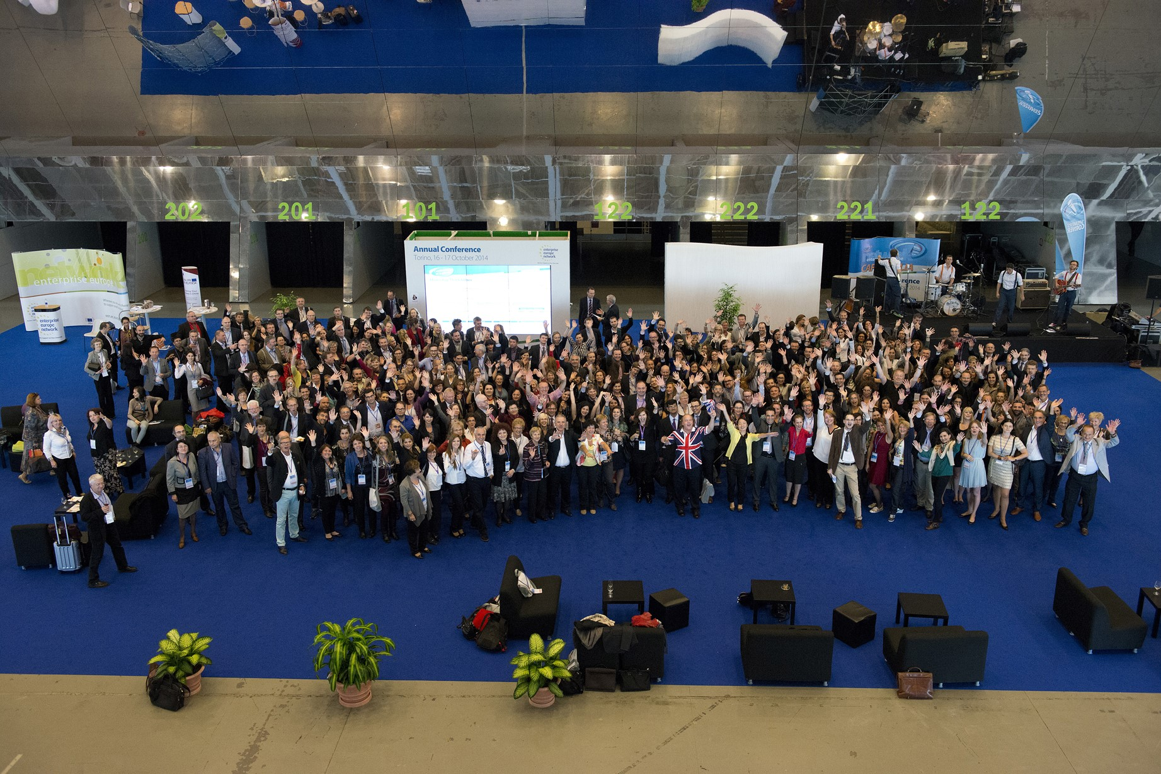
ΕΕΝ-Hellas: European Distinctions(4)
European Best Practice Award 2014
European Best Practice Award 2013

Slide 15
More information: www.enterprise-hellas.gr

